Slide 1
Dynamic Segment Trees for
Ranges and Prefixes
IEEE Transactions on Computers, Vol. 56, No. 6, 2007
Yeim-Kuan Chang and Yung-Chieh Lin
Presenter: Chiou-Ting Tseng
Date: June 11, 2008

Slide 2
Abstract (1/3)
In this paper, we develop a segment tree data structure for solving dynamic table lookup problems. The proposed dynamic segment tree (DST) uses all of the distinct end points of ranges as the keys based on a new range end point scheme. The new end point scheme generates fewer end points than the traditional end point scheme. DST is implemented as a balanced binary search tree augmented with a range set in each node.

Slide 3
Abstract (2/3)
The performance of accessing and updating the ranges stored in each node is improved by an efficient range set data structure that combines the priority queue and the interval tree. Based on the proposed data structures, the time complexities of search, insertion, and deletion in a set of N arbitrary ranges are O(logN), O(logN × logMax), and O(Max × logN × logMax), respectively, where Max is the maximum number of ranges covering any address. In practical routing tables, Max is a small constant (six for the routing tables we tested). The memory requirement for DST is O(N logN).

Slide 4
Abstract (3/3)
The experimental results using real Internet Protocol version 4 (IPv4) routing tables show that both the DST and prefix binary tree on binary tree (PBOB) by Lu et al. (2004) perform much better than the multiway range tree (MRT) by Warkhede et al. (2004) and prefix in B-tree (PIBT) by Lu et al. (2005) in terms of update speed and memory consumption, but DST performs much better than PBOB and a little slower than MRT and PIBT in terms of search speed.

Slide 5
Classless InterDomain Routing
Class A, B, C
When an IP packet is received, the IP router computes the longest matching prefix in its routing table among multiple prefixes that match the destination address of the packet. The packet is then forwarded from the input interface to the output interface associated with the longest matching prefix.

Slide 6
Classless Interdomain Routing (CIDR)
Addressing
128.9.19/24
128.9.25/24
128.9.16/20
128.9.176/20
128.9/16
0
2³²-1
128.9.16.14
Most specific route = “longest matching prefix”

Slide 7
Lookup Scheme
Static Lookup Scheme
  Requires precomputation to improve lookup speed and memory requirement.
  Slow on insert or delete
Dynamic Lookup Scheme
  Online build

Slide 8
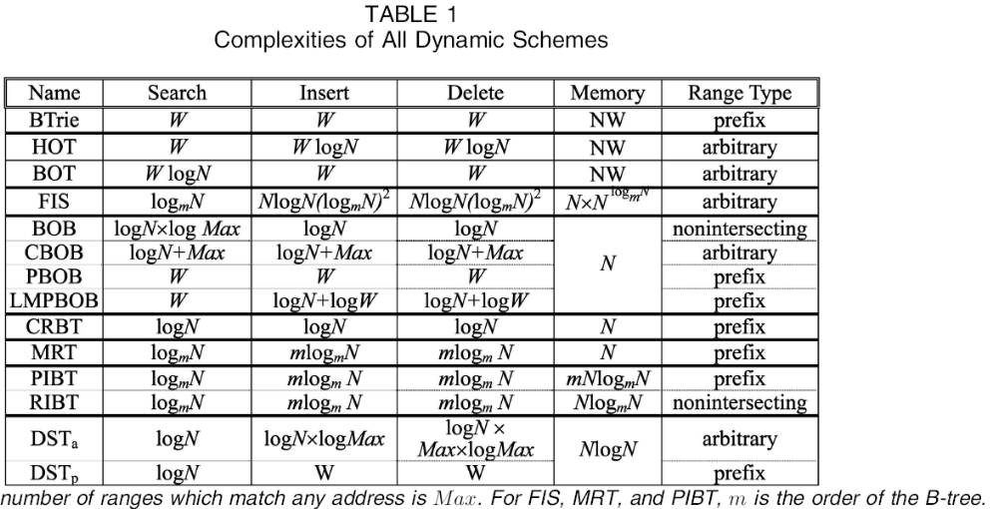
Previous Works
W: bit數？ N: entry數 m: m-way B-tree
Max: 每個addr最多幾個range cover

Slide 9
Conflict
R1=[e1, f1] is said to be more specific than R2=[e2, f2] if e2 ≤ e1 and f1 ≤ f2.
Definition 1. The range set R has a conflict if and only if there exists an address d for which, among all the ranges that cover d, no one range is more specific than the others
d

Slide 10
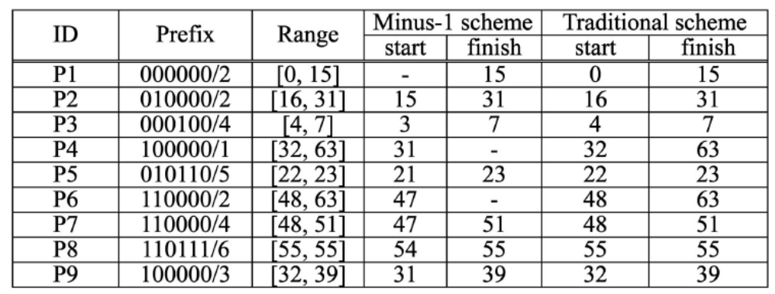
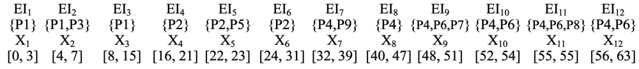
Elementary Interval

Slide 11
Elementary Interval
Let the set of k elementary intervals constructed from a set R of W-bit ranges be X = {X_{i}|X_{i} =[e_{i}, f_{i}], for i = 1 to k}. X must satisfy the following:
1. e₁ = 0 and f_{k} =2^{W} - 1,
2. f_{i} =e_{i+1} - 1 for i =1 to k - 1,
3. all addresses in X_{i} are covered by the same subset of R (called the range matching set of X_{i}), denoted by EI_{i}, and
4. EI_{i} ≠EI_{i+1}, for i = 1 to k - 1.

Slide 12
Minus-1-end Point Scheme

Slide 13
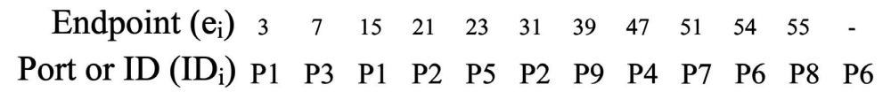
First Algorithm
Binary Search on the ID list.
Insert/ delete requires shifting.

Slide 14
Segment Tree
A data structure designed for storing ranges based on the elementary intervals. The skeleton of the segment tree is a balanced binary search tree in which the keys are the distinct end points of a set R of N original ranges.
The interval covered by an internal node v is the union of elementary intervals corresponding to the leaf nodes in the subtree rooted at v.

Slide 15
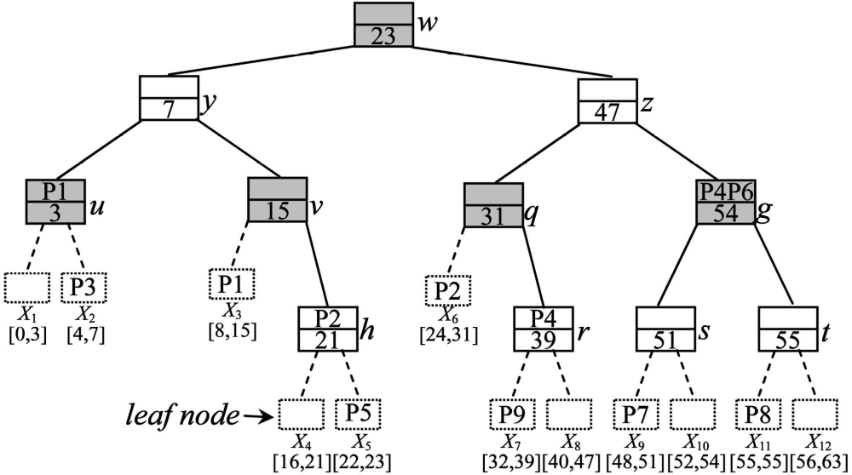
Segment Tree
[0,63]
[0,23]
[24,63]
[0,7]
[8,23]
[24,47]
[48,63]
[16,23]
[32,47]
[48,54]
[55,63]

Slide 16
Dynamic Segment Tree
DST can dynamically insert/delete prefixes or ranges into/from the segment tree.
The proposed DST completely avoids rebuilding the entire data structure while performing updates.
Can be implemented by AVL Tree or Red-black Tree.
Red-black Tree is selected in this paper.

Slide 17
Range Allocation Rule
Range R is stored in the canonical set of node v (v.Cset) if and only if the interval of v (intvl(v)) is contained in R, but the interval of parent(v) (intvl(parent(v))) is not contained in R.

Slide 18
Range Allocation Rule
[0,63]
P2=[16,31]
[0,23]
[24,63]
[0,7]
[8,23]
[24,47]
[48,63]
[16,23]
[32,47]
[48,54]
[55,63]

Slide 19
Cset Property of DST
For each node v in DST, we have 1) v.Cset ∩ v.left.Cset = φ , 2) v.Cset ∩ v.right.Cset = φ , and 3) v.left.Cset ∩ v.right.Cset = φ .

Slide 20
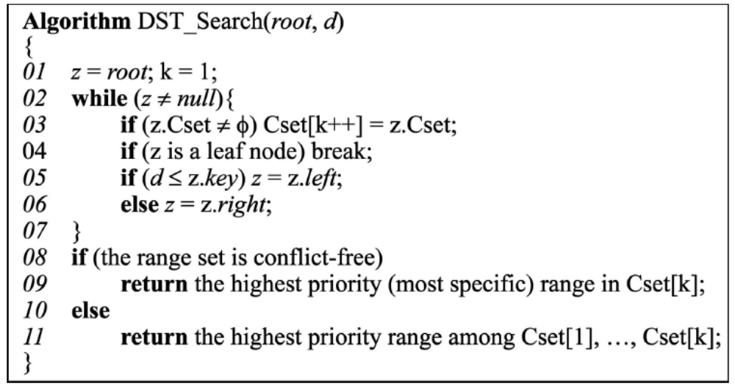
Search in DST

Slide 21
Search in DST
d₁=50
d₂=54
P4=[32,63]
P6=[48,63]

Slide 22
Complexity
If the range set is conflict-free, the time complexity of a DST search is O(log N + g(CSize)) where accessing the highest priority range in a canonical set takes O(g(CSize)) time.
If the range set is arbitrary, the time complexity of a DST search is O(logN + log N × g(CSize)).

Slide 23
Insertion in DST
Inserting R=[e, f] in the DST
If e is not zero, insert e - 1 as a new key in DST.
If f is not 2^{W} - 1, insert f as a new key in DST.
Insert R in DST according to the DST range allocation rule.

Slide 24
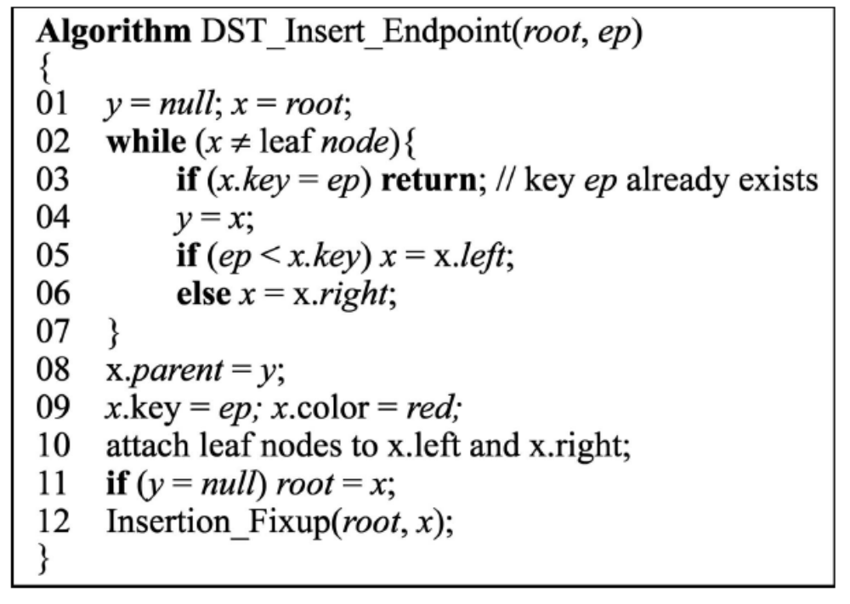
Insertion in DST

Slide 25
Insert Range in DST
Find the lowest common ancestor (LCA), node y, of two nodes with keys e - 1 and f.
If R contains intvl(y), add R in y.Cset.
If e is zero, insert R in y.left.Cset. Otherwise, insert R in u_{i}.right.Cset for i = 1 to m if u_{i}.right ≠ u_{i+1}, where u₁ to u_{m} are the descendants of node y in the path from y to u_{m}, that is, the node with key e - 1, and insert R in u_{m}.right.Cset.
If f is 2^{W} - 1, insert R in y.right.Cset. Otherwise, insert R in v_{i}.left.Cset for i =1 to n if v_{i}.left ≠ v_{i+1}, where v₁ to v_{n} are the descendants of node y in the path from y to v_{n}, that, is the node with key f, and insert R in v_{n}.left.Cset.

Slide 26
Insertion in DST
[0,63]
P1=[0,15]
[0,23]
[24,63]
[0,7]
[8,23]
[24,47]
[48,63]
[16,23]
[32,47]
[48,54]
[55,63]

Slide 27
Insertion in DST
[0,63]
P2=[16,31]
[0,23]
[24,63]
[0,7]
[8,23]
[24,47]
[48,63]
[16,23]
[32,47]
[48,54]
[55,63]

Slide 28
Insertion in DST
[0,16]
8
[0,8]
[9,16]
4
12
[5,8]
[9,12]
[13,16]
[0,4]
2
6
10
14
[3,4]
[5,6]
[7,8]
[9,10]
[11,12]
[13,14]
[15,16]
[0,2]
1
3
5
7
9
11
13
15

Slide 29
Complexity
Insert endpoint: O(logN) + O(CSize × f(CSize))
Insert range: O(logN × f(CSize))
Total: O((logN + CSize) × f(CSize))

Slide 30
Optimized Insertion
The insertion algorithm proposed above takes three separate steps sequentially to complete the insertion process.
In the optimized insertion, inserting the two end points of a range R are performed while inserting R.
Detail omitted.

Slide 31
DST Rotations
For DST, changing colors and pointers is the same as that in the original red-black tree and is thus straightforward.
However, changing the pointer structure also alters the relative positions of the canonical sets involved in rotations.

Slide 32
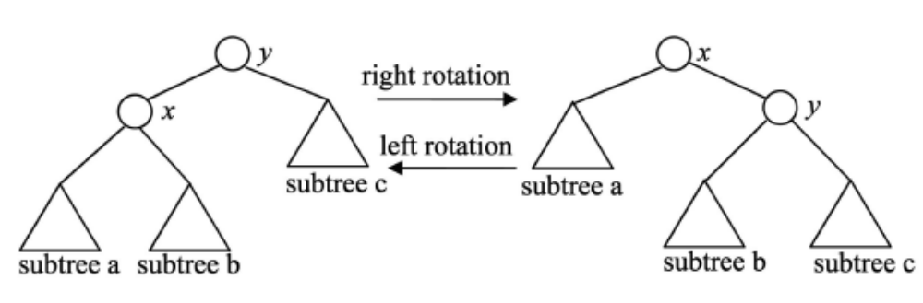
DST Rotations
intvl(x)=a ∪ b
intvl(y)=a ∪ b ∪ c
intvl(x)=a ∪ b ∪ c
intvl(y)=b ∪ c

Slide 33

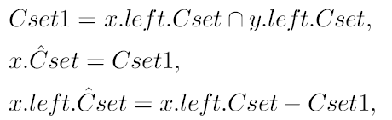
Left Rotation

Slide 34
Left Rotation
[0,15]
[0,15]
5
10
[11,15]
[0,5]
R1
10
[6,15]
[0,10]
5
R1
[6,10]
R1
[11,15]
[0,5]
[6,10]
R1 = 0 ~ 10

Slide 35
Time Complexity
Assume that the size of the canonical set is O(CSize) and inserting/deleting a range into/from a canonical set takes O(f(CSize)) time. Since there may be O(CSize) ranges that are inserted into or deleted from a canonical set, the time complexity of a rotation is O(CSize × f(CSize)).

Slide 36
DST Deletion
Deleting a range R = [e, f] from DST needs the following steps:
Remove R from all canonical sets that contain R based on the range allocation rule.
If e is not zero, determine if the node z with key e - 1 needs to be deleted from DST. If so, the following operations must also be performed:
  Adjust the canonical sets of some nodes in the subtree rooted at node z.
  Rebalance the tree.
If f is not 2^{W} - 1, this step is the same as Step 2 with keys e - 1 and f exchanged.

Slide 37
DST Deletion
To delete an end point, we must make sure that this end point is not also the start or finish point of another range.
After a range is removed from DST, if EI_{i} and EI_{i+1} become the same, node z should be removed from DST.

Slide 38

DST Deletion

Slide 39
Delete a Leaf Node
Reset node z as a leaf node.
Remove the two leaf nodes of node z.
Perform a red-black tree fix-up operation from node parent(z) up to the root.

Slide 40
Delete a Leaf Node
[0,63]
[0,23]
[24,63]
[0,7]
[8,23]
[24,47]
[48,63]
[16,23]
[32,47]
[48,54]
[55,63]

Slide 41
Delete a Node of Degree 1
w.l.o.g. z = z.parent.left, z.left is the leaf
z_{c}.Cset = z.Cset.
z.parent.left = z.right.
Change the color of node z.right to black.
Delete node z and leaf node z.left from DST.

Slide 42
Delete a Node of Degree 1
[0,63]
P2=[16,31]
[0,23]
[24,63]
[0,7]
[8,23]
[24,47]
[48,63]
[16,23]
[32,47]
[48,54]
[55,63]

Slide 43
Delete a Node of Degree 2
Replace z.key with y.key and then delete y, where y is either z’s successor or z’s predecessor in the tree.
If the number of canonical set operations needed for replacing node z with successor(z) is less than or equal to that needed for replacing z with predecessor(z), we select successor(z) to replace z. Otherwise, we select predecessor(z) to replace z.
If y = successor(z), y must have no left child. Similarly, if y = predecessor(z), y must have no right child.

Slide 44
Delete a Node of Degree 2

Slide 45
Delete a Node of Degree 2
z.key = y.key.
v_{n-1}.left = w_{n+1} (z.right = w₁ if n = 1).
w_{n+1}.Cset = w_{n+1}.Cset ∪ v_{n}.Cset.
For each range R =[e, f] in w_{n+1}.Cset, m = k if v_{k}.key ≤ f < v_{k-1}.key for 0 < k ≤ n - 2 or m = 0 if v₀.key ≤ f, we perform the following operations:
  Delete R from w_{i}.Cset, for i =n + 1 to m + 2.
  Add R in v_{m+1}.Cset.
Remove node y and y’s left leaf child.
Perform the red-black tree fix-up operation from node w_{n+1} up to the root.

Slide 46
Delete a Node of Degree 2
2
[0,63]
P4=[32,63]
[0,23]
5
[24,63]
[0,7]
[8,23]
[24,47]
4
[48,63]
3
[16,23]
4
[32,47]
[48,54]
[55,63]
1

Slide 47
Time Complexity
O(logN × Max × f(Max))

Slide 48
Data Structure for Canonical Sets
For arbitrary range: Combines the priority queue and the thin interval tree.
Ins/del: O(log CSize) time
For prefix range: combine bit vector and linear list.
Ins/de: O(W) time

Slide 49
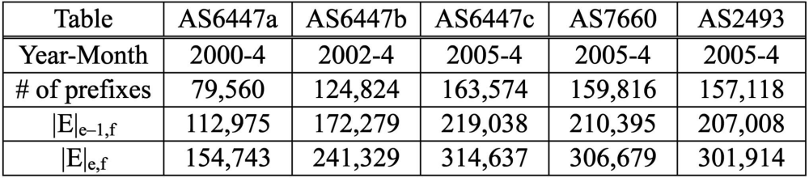
Experimental Input
The first three routing tables having the same AS number are obtained from the same Border Gateway Protocol (BGP) backbone router [17] at different times and the other two tables are from [2].

Slide 50
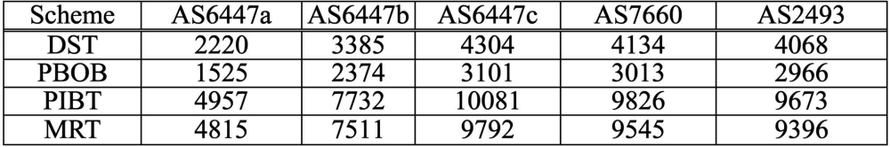
Memory Requirement

Slide 51
Experiment
To measure the search times, we randomized the start addresses of all prefixes in the original routing table as the input IP traffic in the simulation.
We first construct the data structure for each scheme according to the original routing table. Next, we randomly delete 5 percent of the prefixes from the structure we built to obtain the deletion times.
Then, we randomly insert these deleted prefixes back into the structure to obtain the insertion times.

Slide 52
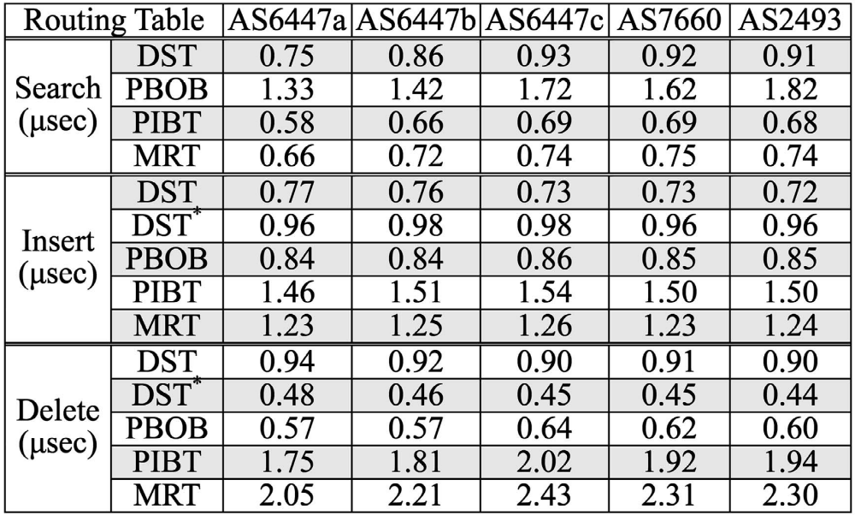
Resulting Time

Slide 53
Example

